Slide 1
CS2303: Systems Programming Concepts
Class 18
“Under the Hood” of Polymorphism
Thanks for Prof. Lauer for an earlier version of these slides.
Copyright 2005-2017, Michael J. Ciaraldi

Slide 2

Not This One…

Slide 3
Review – Virtual Functions
E.g.,
class Shape {
public: virtual ~Shape(); virtual void Rotate(); virtual void Draw() = 0; ...
}
virtual means that any derived class may override method.
pure virtual means that every derived class must override method (to become concrete).

Slide 4
Implementation Overview
Compiler adds table of function pointers
Every object of class with virtual
Including every derived class
Result:–
possible to reach correct method from any object
See Absolute C++, §15.2 (end)

Slide 5
Compiling Virtual Functions
Virtual Function Table (vtable)
Internal static “member” added to base class
And to each derived class
Contains function pointers for all virtual functions
See Absolute C++, §15.2 (end)

Slide 6
Compiling Virtual Functions (continued)
Constructor sets a pointer in each object to point to appropriate vtable
Executing program indexes into vtable to select appropriate method

Slide 7
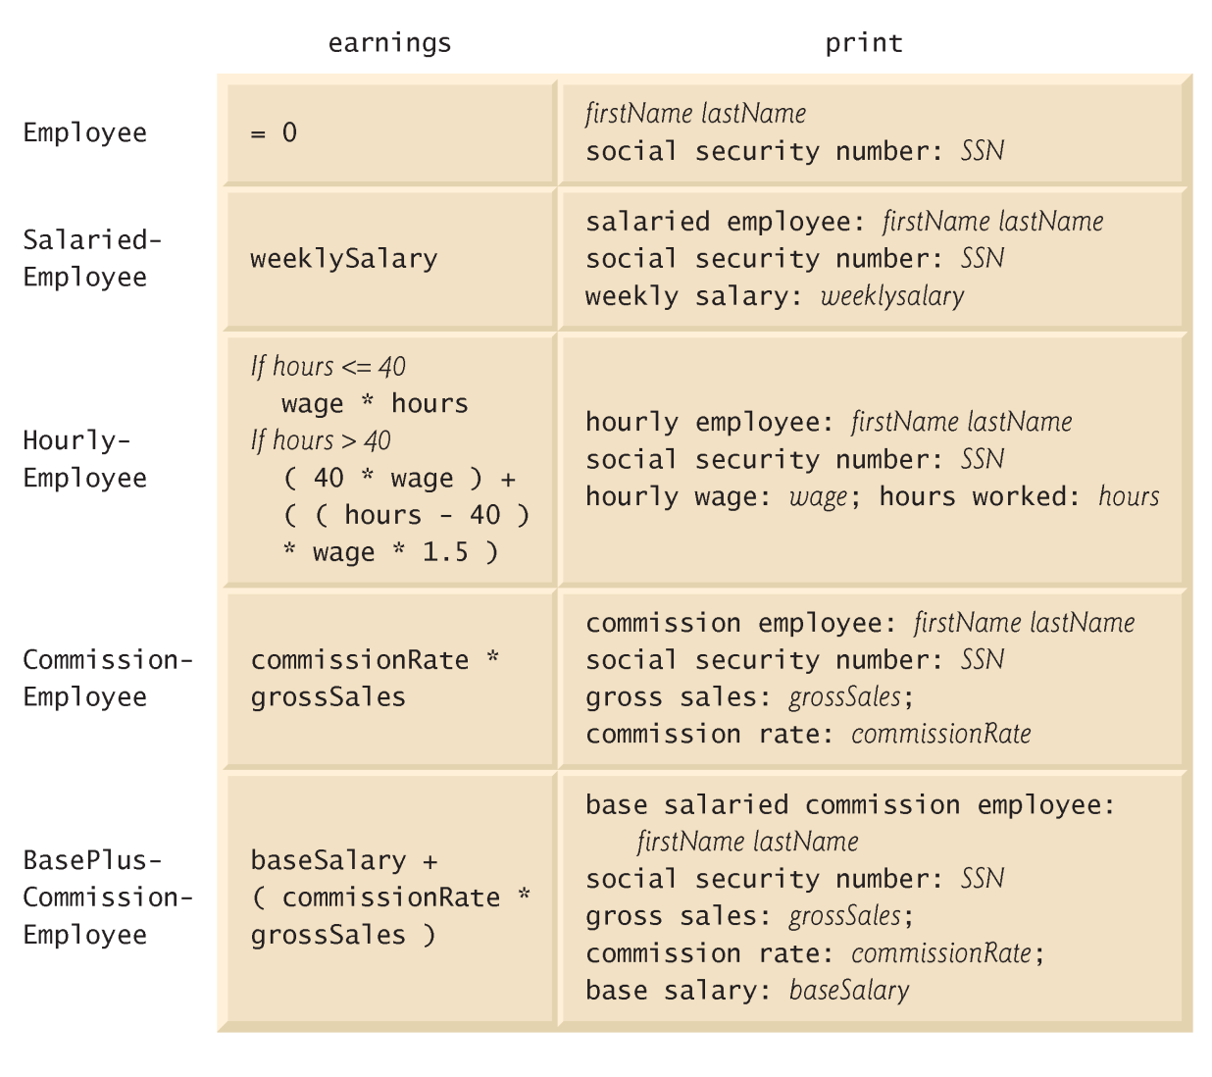
Example
Abstract base class
©1992-2010 by Pearson Education, Inc. All Rights Reserved.

Slide 8
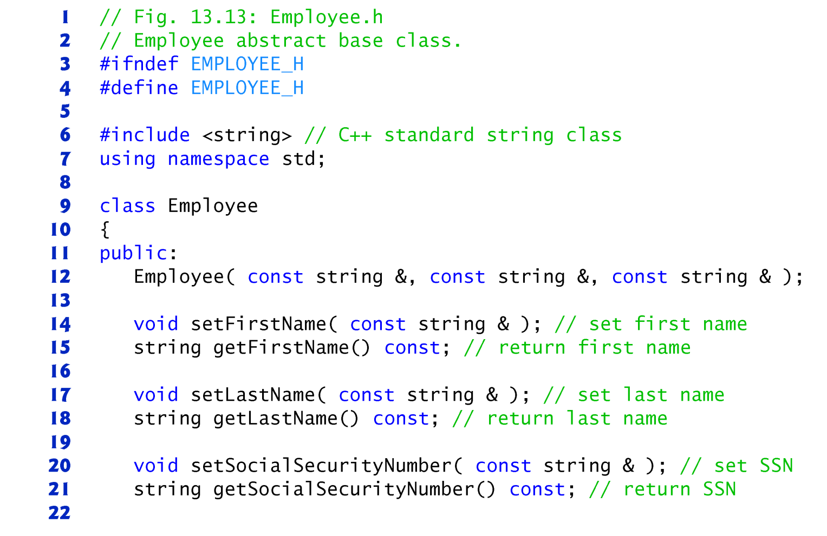
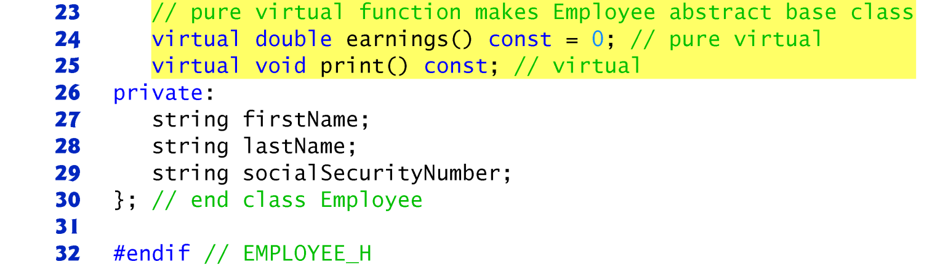
©1992-2010 by Pearson Education, Inc. All Rights Reserved.

Slide 9
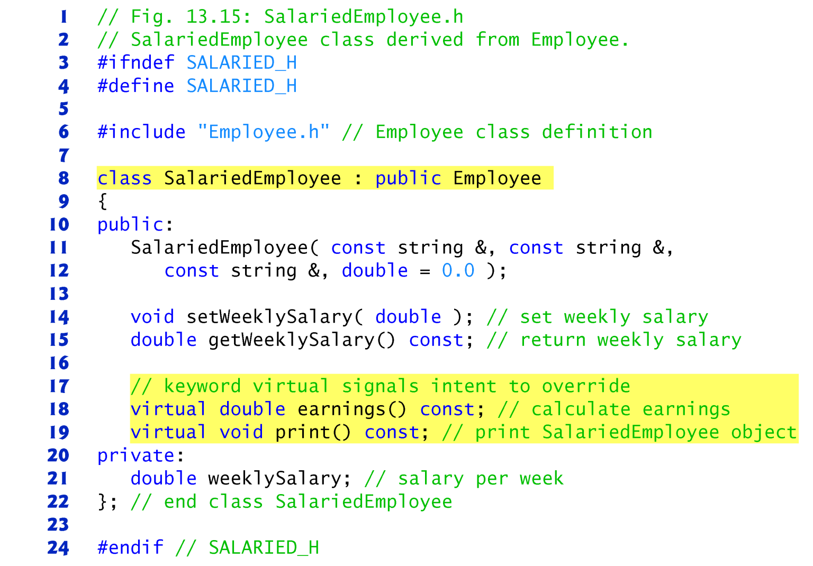
©1992-2010 by Pearson Education, Inc. All Rights Reserved.

Slide 10
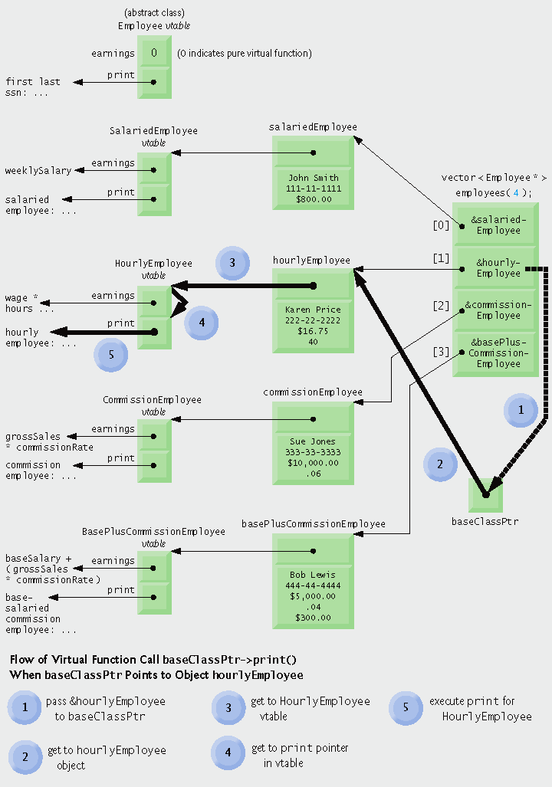
Pointer to object (level 1)
©1992-2010 by Pearson Education, Inc. All Rights Reserved.

Slide 11
Pointer to vtable (stored in every object – level 2)
©1992-2010 by Pearson Education, Inc. All Rights Reserved.

Slide 12
Index into vtable to access method (level 3)
©1992-2010 by Pearson Education, Inc. All Rights Reserved.

Slide 13
Performance Impact
“Nominal”
Must access two additional pointers to get to method
Versus direct access for non-virtual methods
©1992-2010 by Pearson Education, Inc. All Rights Reserved.

Slide 14
Trade-off
Nominal performance impact vs. clarity of thought and ease of programming
Most of the time, clarity of thought wins
Especially with modern optimizing compilers
In some (rare) cases, performance is essential
Note:– Java has similar implementation “” for all methods
Brief (not detailed) description at end of Chapter 15 of Absolute C++

Slide 15
Software Engineering Observation
Dynamic binding enables independent software vendors (ISVs) to distribute software without revealing proprietary secrets.
Software distributions can consist of only header files and object files
No source code needs to be revealed.
Software developers use inheritance to derive new classes from those provided by the ISVs
Previous software that works with the ISVs’ classes still work with the derived classes
Will use the overridden virtual functions provided in these classes (via dynamic binding).

Slide 16
Software Engineering Observation (example)
Develop a plug-in for, say, Photoshop
Can still use all of Photoshop’s tools on your images
Powerful method for innovation, leveraging existing code to drive new ideas

